Slide 1

Determining the Tangible Conclusions that Can Be Drawn from COVID-19 Case Data for Strategic Supply Chain Decisions
Theodore Endresen （安多）

Slide 2
Significance
Why my research is important and would be valuable to pursue?

Slide 3
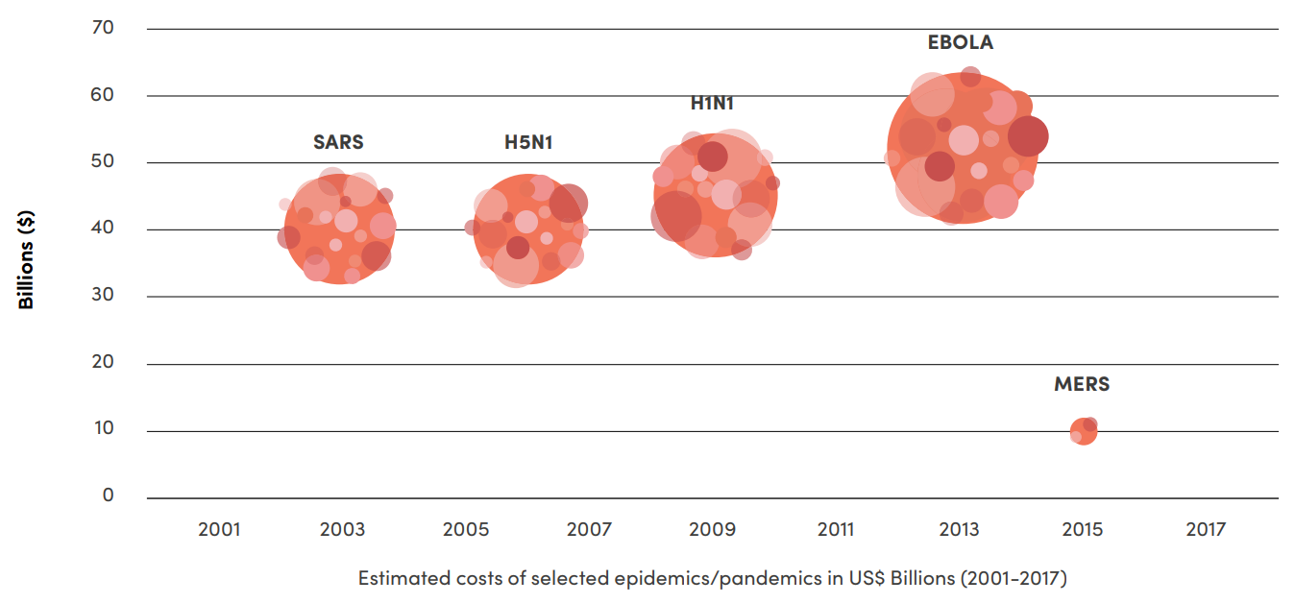
Significance
Pandemics prior to COVID-19 have extracted a massive economic impact on the global economy [1]

Slide 4
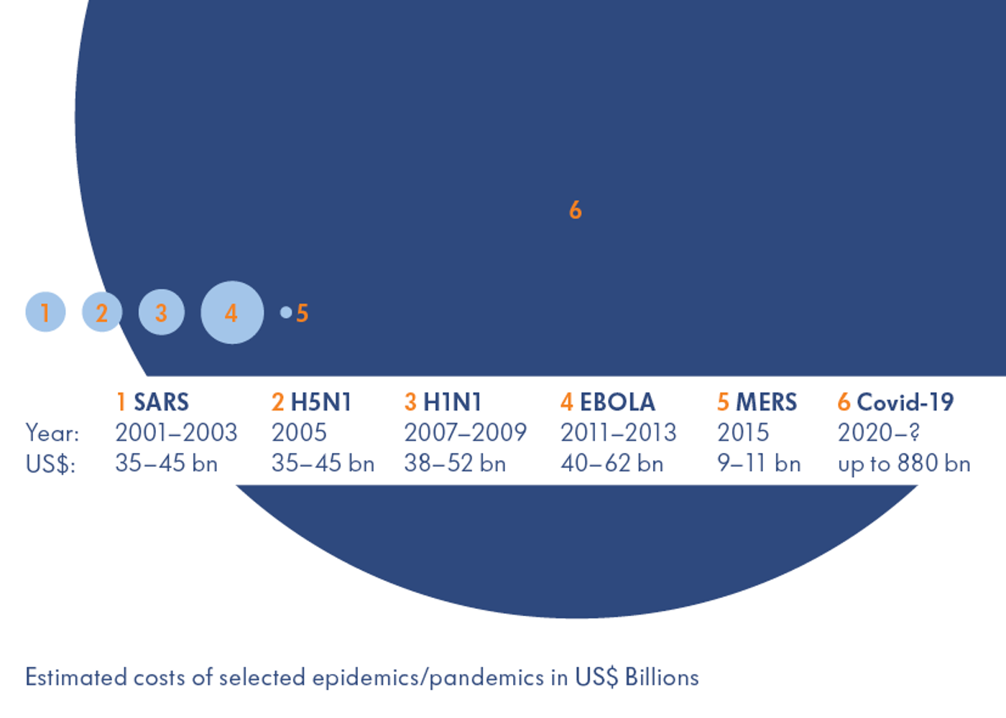
Significance
However, the economic impact of these prior pandemics pale in comparison to the estimated economic impact of COVID-19, which has estimated to be $880 billion in 2020 [2] and $12 trillion by 2040 [3].

Slide 5
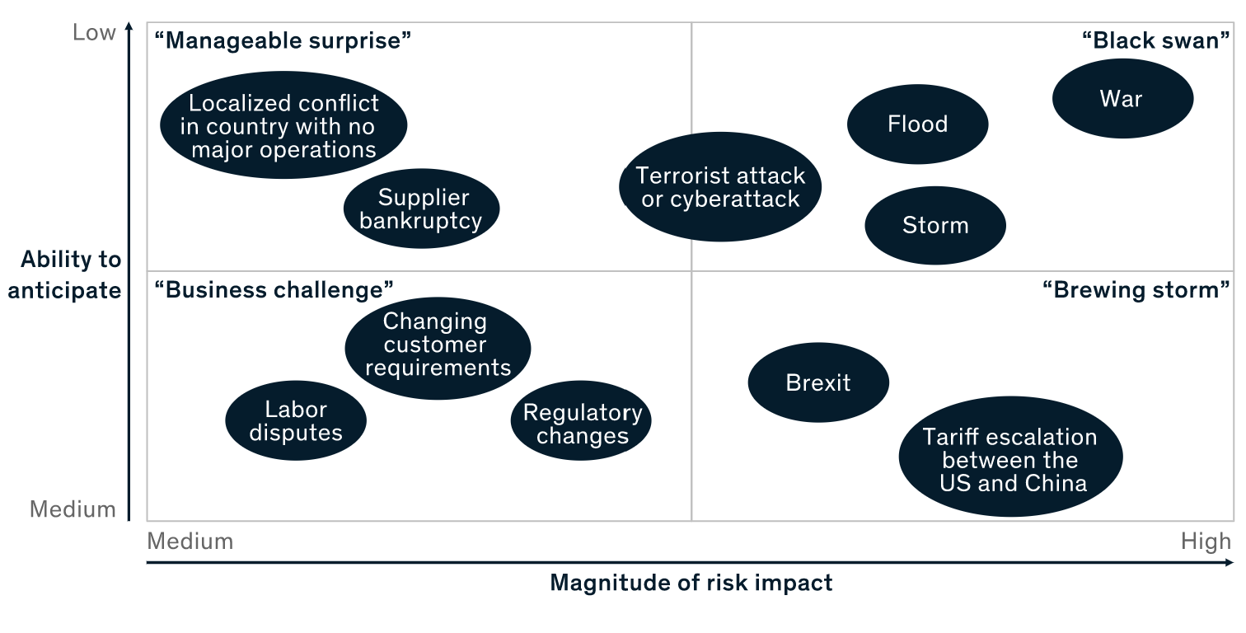
Significance
In addition to current Black Swan supply chain risk strategies (i.e. wars, floods, storms, and terrorist attacks) pandemic preparedness will surely, and needs to be, considered in the future [4].

Slide 6
Significance
There exists a wealth of data documenting COVID-19 case, death, and testing numbers.
The question(s) companies will face is how to fairly and accurately parse through this data in order to draw information about a country’s or region’s pandemic preparedness from this data.

Slide 7
Research Objective
What I hope to accomplish through my research?

Slide 8
Research Objective
Overall Objective:
To sift through, and make sense of, the current COVID-19 case, death, and testing data in order to determine what conclusions can be drawn from it.
To do so, a list of metrics that captures the results of a country’s COVID-19 response that can be drawn from the COVID-19 data must be created and calculated.

Slide 9
Research Objective
Then, these calculated metrics can be compared to economic, healthcare, and press independence data in order to try and discover and underlying trends.
Additionally, these calculated metrics can be compared to John’s Hopkins Global Health Security (GHS) Rankings released in October 2019 [5], which are a measure of estimated pandemic preparedness.

Slide 10
Research Objective
Finally, based on the analyses, I should be able to draw tangible conclusions that determine the effectiveness of a country’s COVID-19 response, what other prior known indicators played a significant role in predicting a countries observed COVID-19 response, and how accurate John’s Hopkins 2019 GHS Rankings were.

Slide 11
Methodology
How I propose I should conduct my research?

Slide 12
Methodology – Date Sources
We need to following data for every country in order to conduct this research:
Total Deaths
Total Cases
Total Tests
From this data, we should be able to extrapolate all necessary metrics to conduct our analyses

Slide 13
Methodology – COVID-19 Date Sources
The COVID-19 Case and Death data can be obtained through Johns Hopkins’ Whiting School of Engineering’s Center for Systems Science and Engineering public Github page [6].
The COVID-19 Testing data can be obtained through Our World in Data’s public Github page [7].
Both these data sources have been vigorously tracking and publishing their data sources, so they can be appropriately used for our research.

Slide 14
Methodology – Economic Comparison
In order to do the economic comparison, we can utilize economic data from the International Monetary Fund’s (IMF) April 2020 World Economic Outlook Report [8].
From this data, we will most likely look at the following data
GDP Per Capita
Unemployment Rate
Government Finance

Slide 15
Methodology – Healthcare Comparison
In order to do the healthcare comparison, we can utilize healthcare ranking data from the World Health Organization (WHO) report titled Measuring Overall Health System Performance For 191 Countries [9].
This report created a composite score that weighted every country’s healthcare’s efficiency versus their quality and equity.

Slide 16
Methodology – Press Independece Comparison
In order to the press independence comparison, we can utilize the data from the 2020 World Press Freedom Index Rankings published by Reporters Without Borders [10]
In addition to ranking each country, the report also assigned each country a score which they have also correlated to a categorical rating.

Slide 17
Methodology – John’s Hopkins Pandemic Preparedness Comparison
The Johns Hopkins GHS Rankings [5] pose an interesting area of study because they were released in October 2019. Thus, they give us a great view of what pandemic preparedness was viewed to be before the COVID-19 outbreak.
The reports ranks every country and provides a score across six dimensions of pandemic preparedness (prevent, detect, respond, health, norms, and risk) as well as an aggregated overall ranking.

Slide 18
Methodology – University of Oxford Stringency Index
Researchers at the University of Oxford have put together a Stringency Index that “systematically collects information on several different common policy responses that governments have taken to respond to the pandemic on 17 indicators such as school closures and travel restrictions” [11].
This data can also be used to leverage the COVID-19 metrics I calculate and the John’s Hopkins Pandemic Preparedness Metrics.

Slide 19
Methodology – Metrics
Based on the COVID-19 Cases, Deaths, and Testing data, we must put together a list of metrics that can be used to measure the results of a country’s COVID-19 pandemic response.

Slide 20
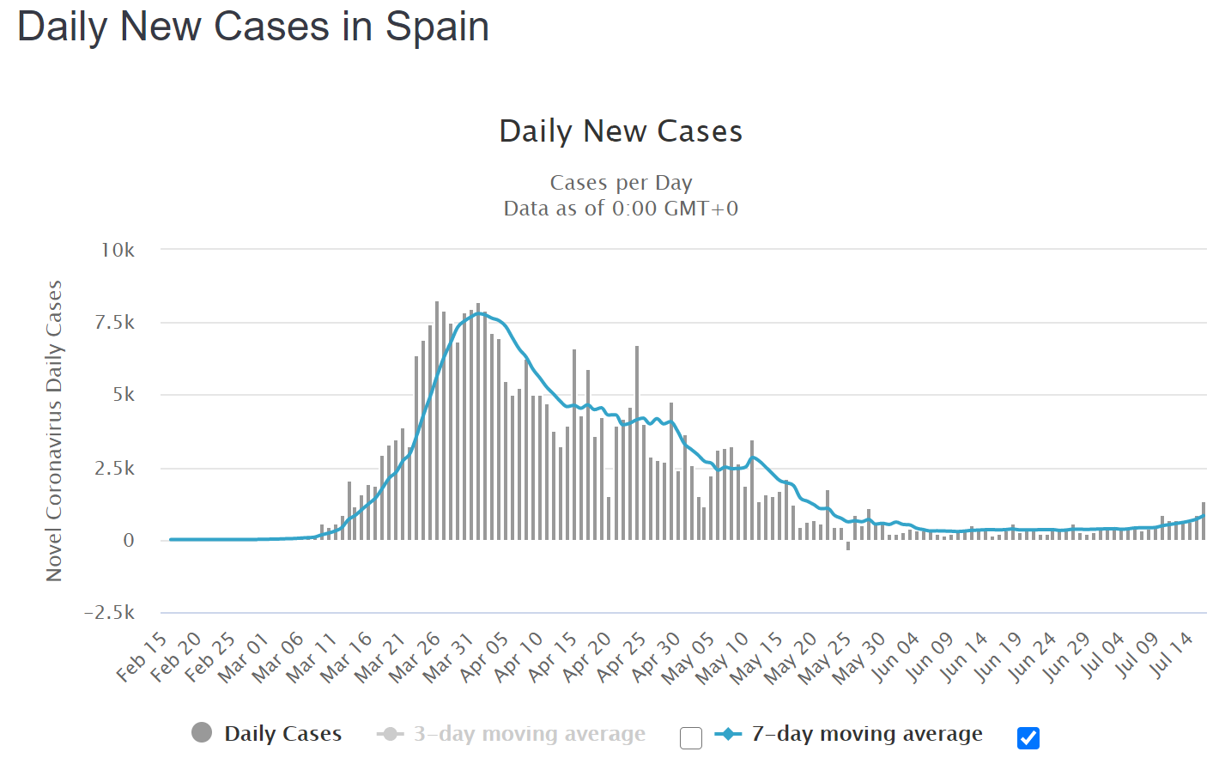
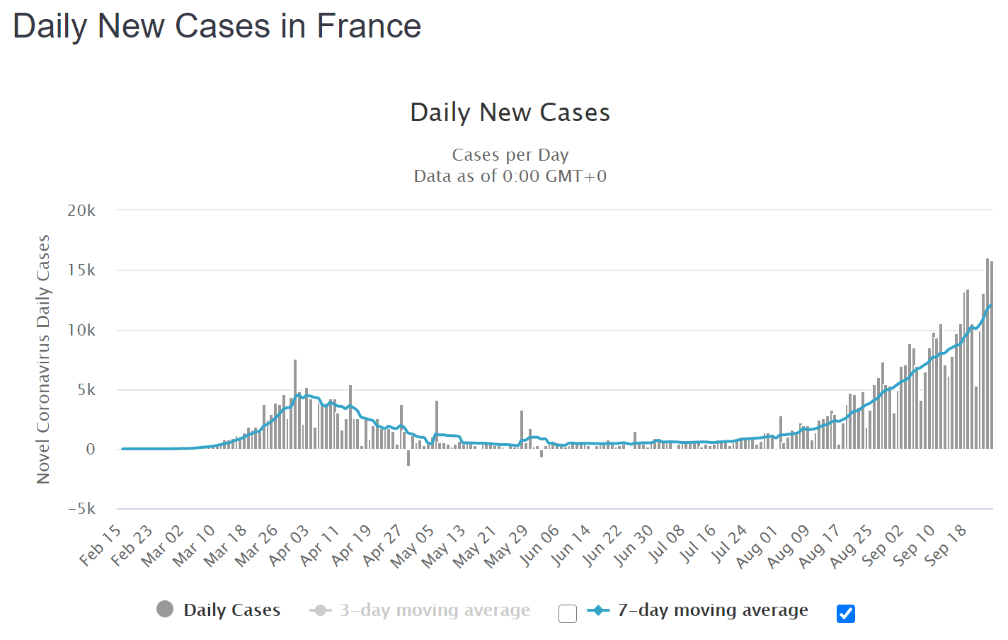
Methodology – Metrics: Number of Outbreaks
n=1
This metric would seek to explain the amount of outbreaks, n, that a single country experienced.
n=2
n=2

Slide 21
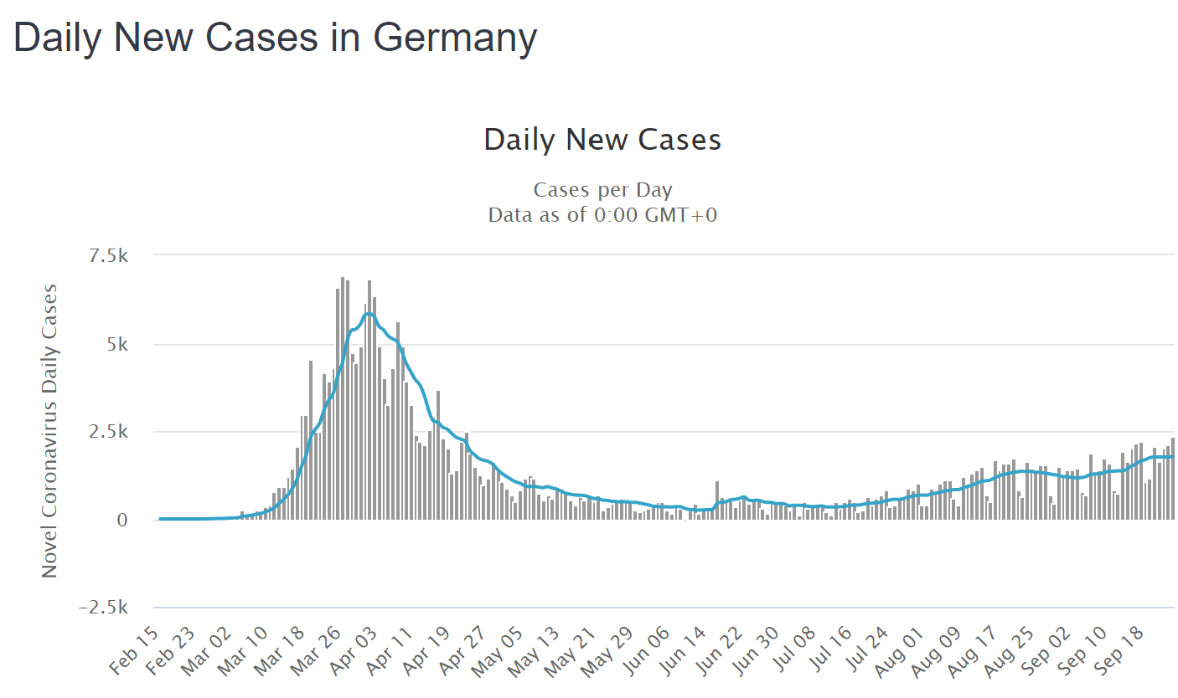
Methodology – Metrics: Severity of Subsequent Outbreaks
This metric would seek to explain the sustained response of a country’s COVID-19 response. The lower the peak of subsequent outbreaks, the better the COVID-19 response.

Slide 22
Methodology – Metrics: Length of Outbreak
This metric would seek to explain the amount of time the pandemic within a country underwent uncontrolled growth during it’s nth outbreak.

Slide 23
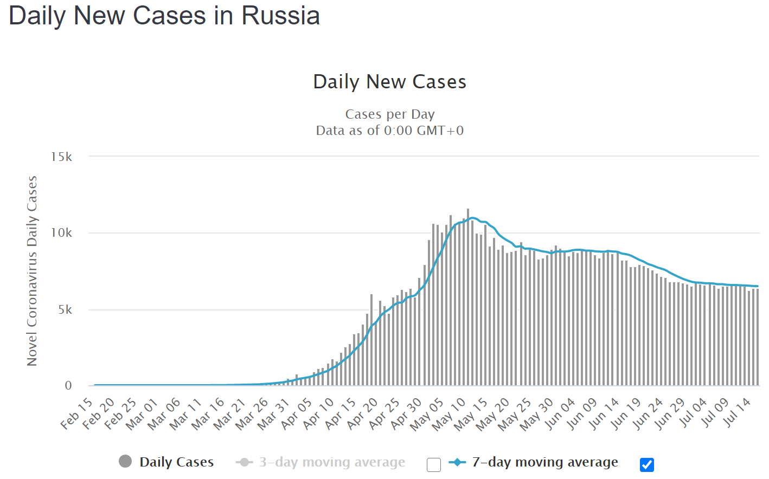
Methodology – Metrics: Rate of Outbreak
This metric would seek to explain the rate of uncontrolled growth a country faced during their nth outbreak.

Slide 24
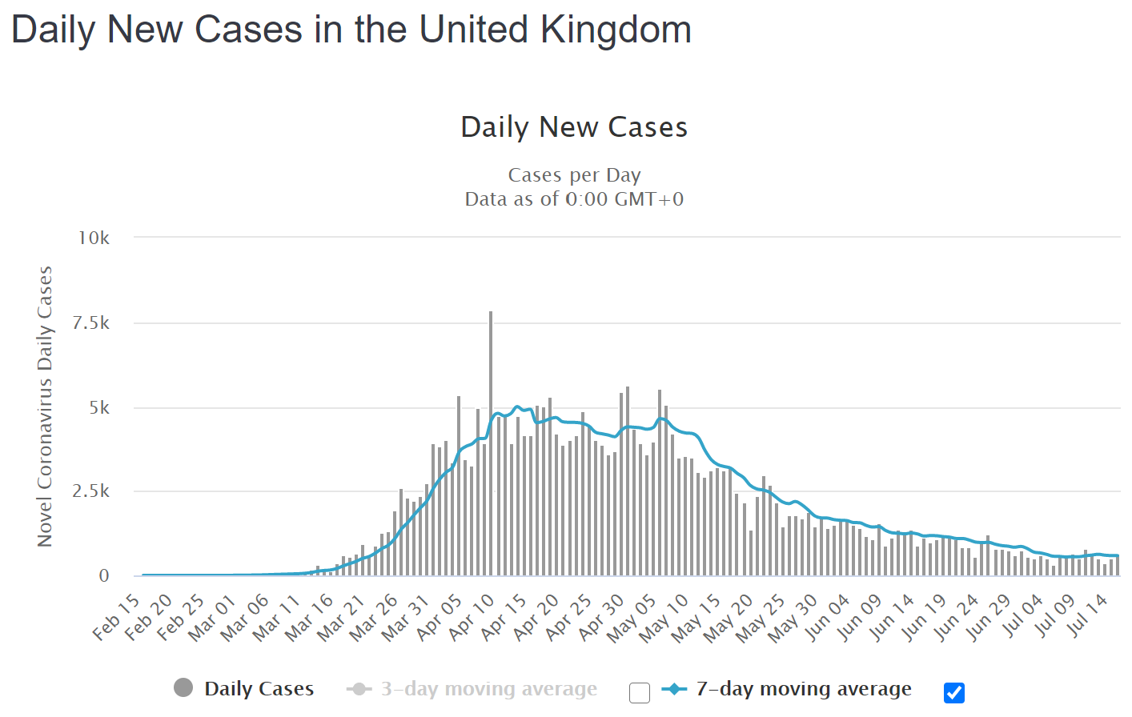
Methodology – Metrics: Time to Submission
This metric would seek to explain the amount of time it took, after the pandemic within a country had stop experiencing uncontrolled growth, for a country to reduce its number of cases to where the pandemic could be considered submitted for it’s nth outbreak.

Slide 25
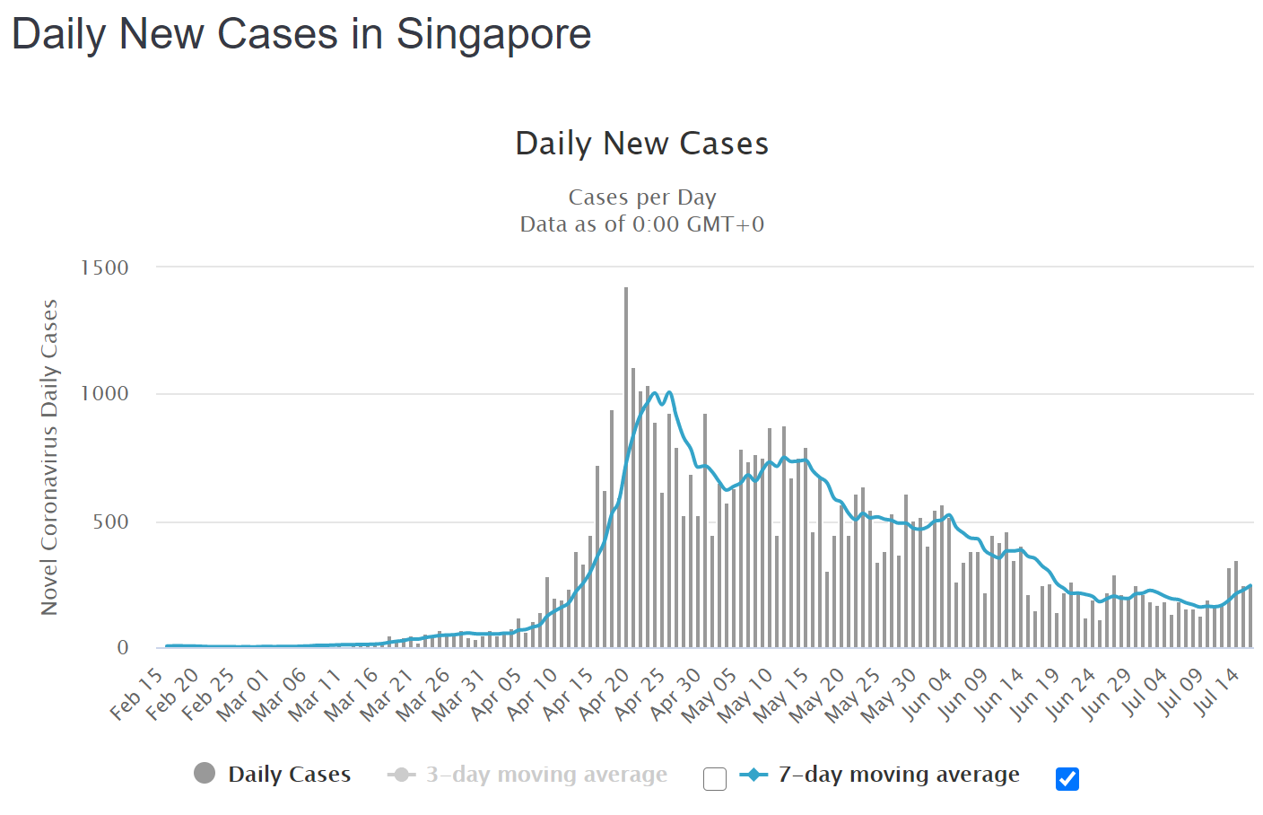
Methodology – Metrics: Rate of Submission
This metric would seek to explain the rate at which a country got their pandemic under control, after the pandemic within a country had stop experiencing uncontrolled growth, to the point at which it could be considered under submission or began its subsequent nth outbreak.

Slide 26

Case to Death Ratio Average
This single data point would represent a country’s death rate at the time of running the analysis. It is worthy to include because it may indirectly correlate to the quality of healthcare faculties in each country,
$$\frac{Total Deaths}{Total Cases}$$

Slide 27
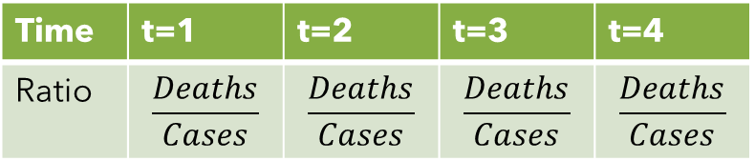
Case to Death Ratio over Time
This metric would be a time series of the case to death ratio over time. This indicator is worthy to include because it may be an indicator of how effective a country’s pandemic control measures were at protecting vulnerable populations.
Time | t=1 | t=2 | t=3 | t=4
Ratio | $$\frac{Deaths}{Cases}$$ | $$\frac{Deaths}{Cases}$$ | $$\frac{Deaths}{Cases}$$ | $$\frac{Deaths}{Cases}$$

Slide 28

Case to Tests Ratio Average
This single data point would represent the relationship between the number of tests done to the number of cases. This is worthy to include as it may indirectly relate to the quality of a country’s healthcare system.
$$\frac{Total Cases}{Total Tests}$$

Slide 29
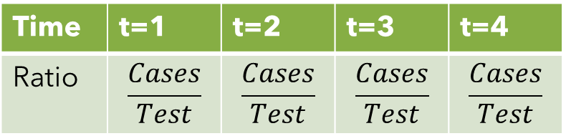
Case to Tests Ratio over Time
This metric would be a time series of the case to test ratio over time. This indicator is worthy to include because it may be an indicator of the quality of a country’s healthcare system.
Time | t=1 | t=2 | t=3 | t=4
Ratio | $$\frac{Cases}{Test}$$ | $$\frac{Cases}{Test}$$ | $$\frac{Cases}{Test}$$ | $$\frac{Cases}{Test}$$

Slide 30
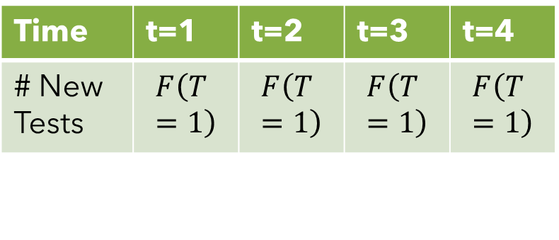
Testing Rate over Time
This time series metric would show how many tests a country was able to do over time. This would be important to know as it would show how well a country was able to respond to the pandemic.
Time | t=1 | t=2 | t=3 | t=4
# New Tests | $$F\left(T=1\right)$$ | $$F\left(T=1\right)$$ | $$F\left(T=1\right)$$ | $$F\left(T=1\right)$$

Slide 31
Known Challenges and Proposed Solutions
The challenges I know I must solve in order to conduct my research and how I think they can be sovled.

Slide 32
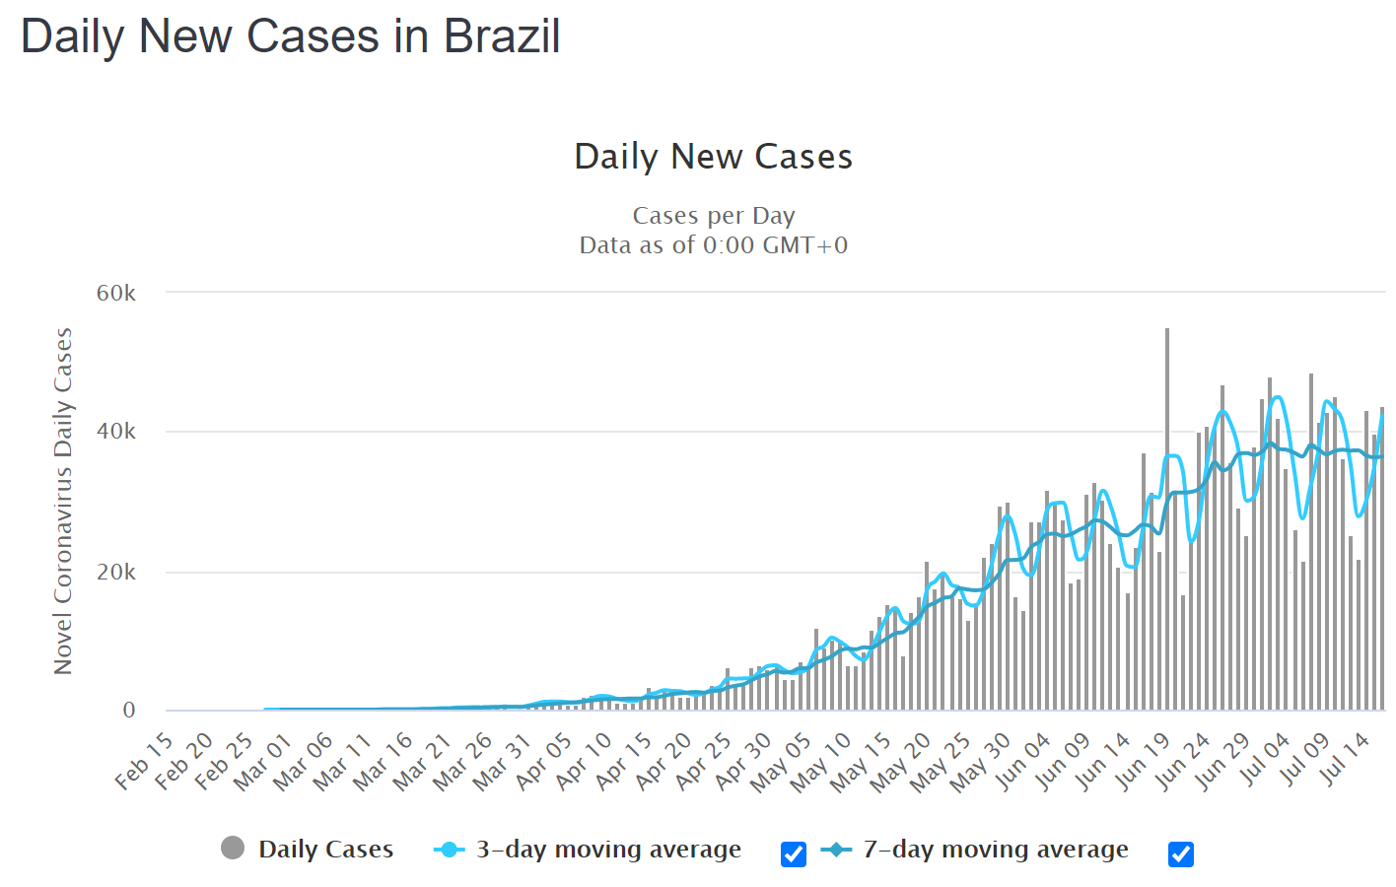
Periodicity of Data
Many country’s data exhibits a great deal of weekly periodicity. Therefore, in order to make the data processing more accurate, a 7-10 day moving average should be applied.

Slide 33
How to Measure Cases, Deaths, and Tests
Countries have vastly different populations. Therefore, to make sure all countries are compared accurately, all data needs to be converted to indicants per 100,000 or 1,000,000 people.

Slide 34
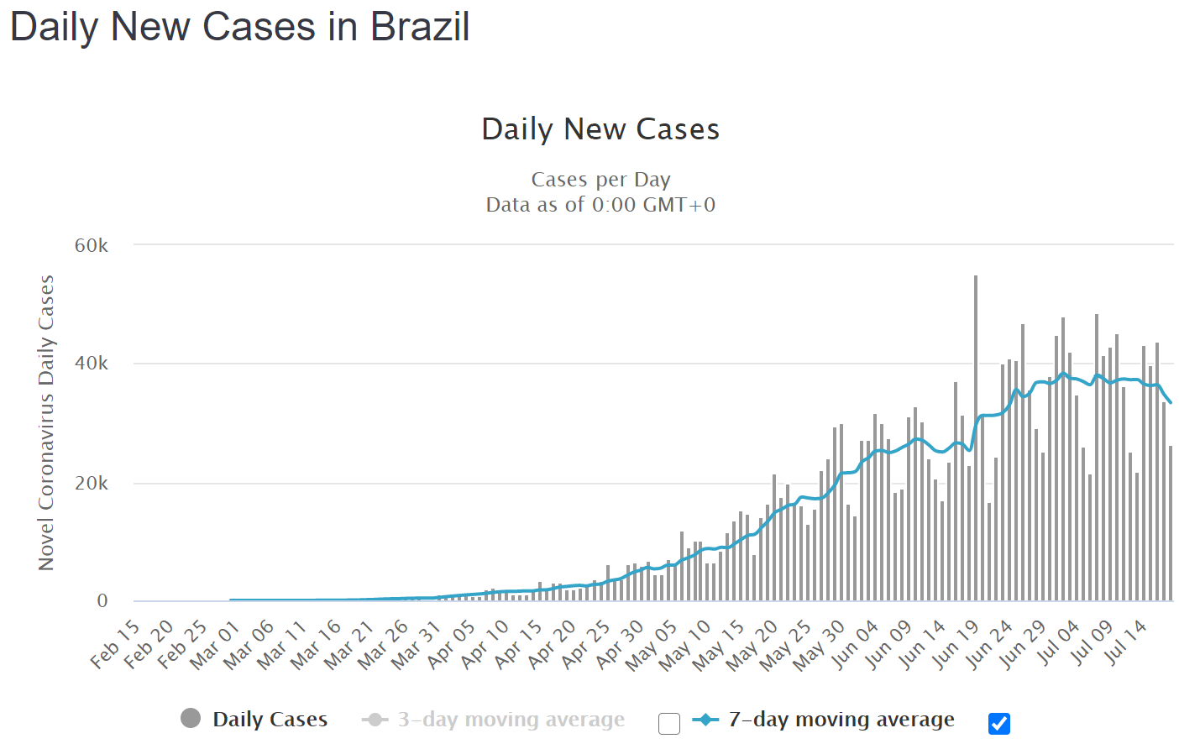
Describing and Smoothing Distributions
In order to obtain useful information from the COVID-19 case data, we must first smooth the data in order to remove the elements of weekly periodicity from the data. This can be achieved, as previously mentioned, through a moving average.

Slide 35
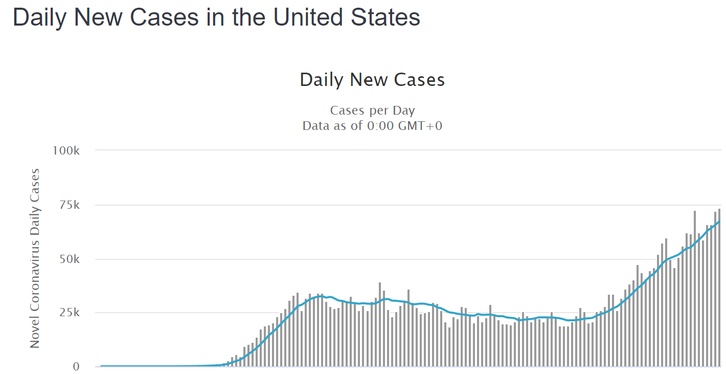
Describing and Smoothing Data
However, even by utilizing such smoothing methods, the data is not quite usable to determine the start and end points of different portions of curves. For example, although Signapore saw an increase in cases, I would not consider it a second outbreak like we see in the US Data.

Slide 36
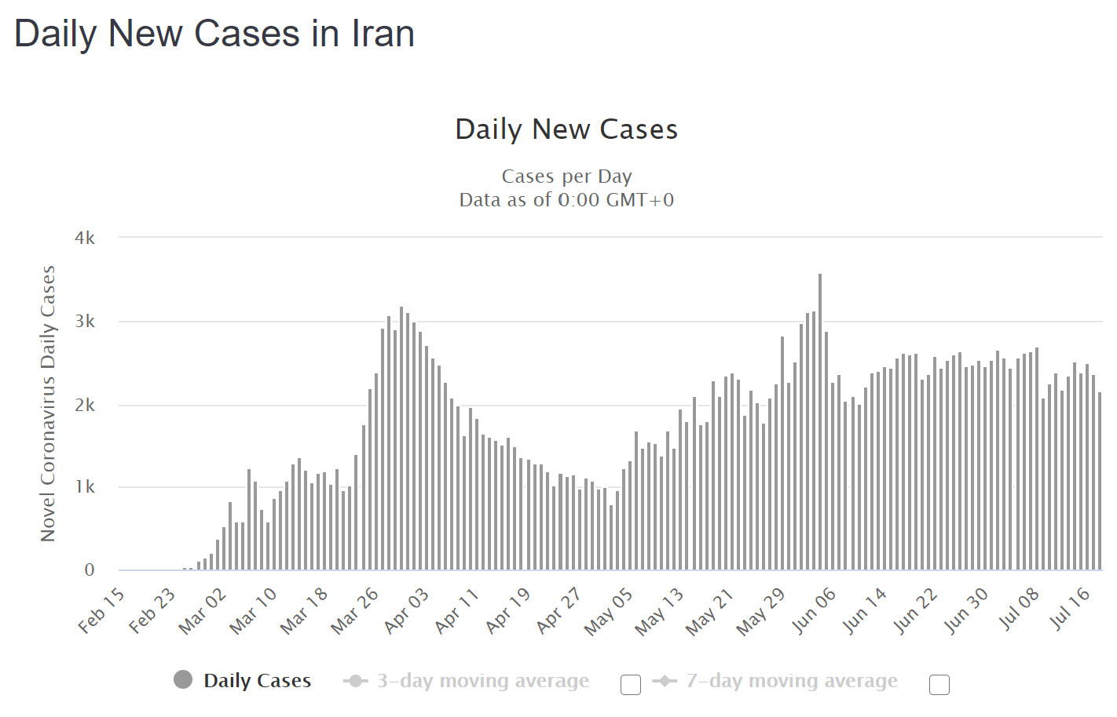
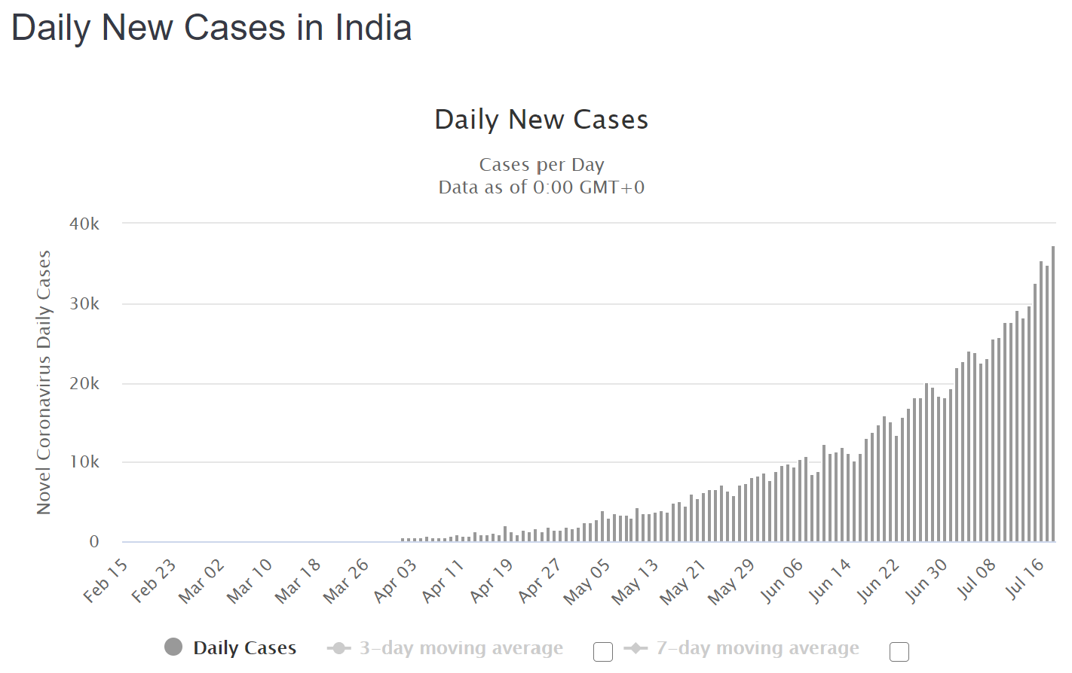
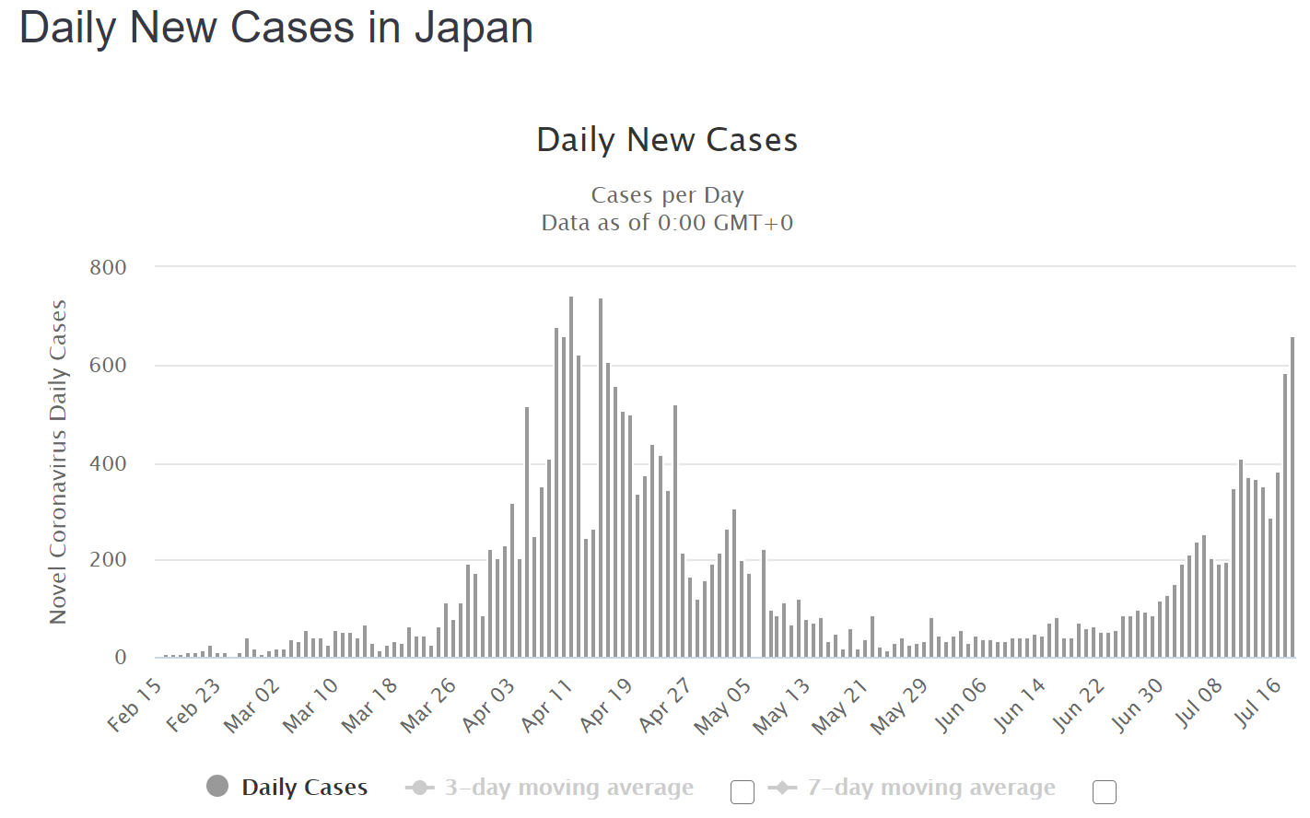
Describing and Smoothing Data
Although we could go through every country’s data and manually choose start and end points, this would be a worst-case scenario. However, due to the sheer number of countries we need to analyze, creating a list of rules that would encapsulate every country’s unique data would be cumbersome.

Slide 37
Describing and Smoothing Data
To solve this issue, I think we can utilize the following python libraries to create curve fitted functions from which we can determine the first derivatives to determine the start and end points of the different outbreaks.
curve_fit
Utilizes optimization to determine the coefficients of a pre-input non-linear function
f_solve
Utilizes optimization to determine the roots of an inputted nonlinear function

Slide 38
Describing and Smoothing Data
By feeding different functions (i.e. quadratic, cubic, quartic, exponential, Poisson, etc.) to curve_fit to be fitted to the data and selecting the result with the best R^2 value, we can systemically and repeatably get a smoothened function for which to determine an outbreak’s start and end points.

Slide 39
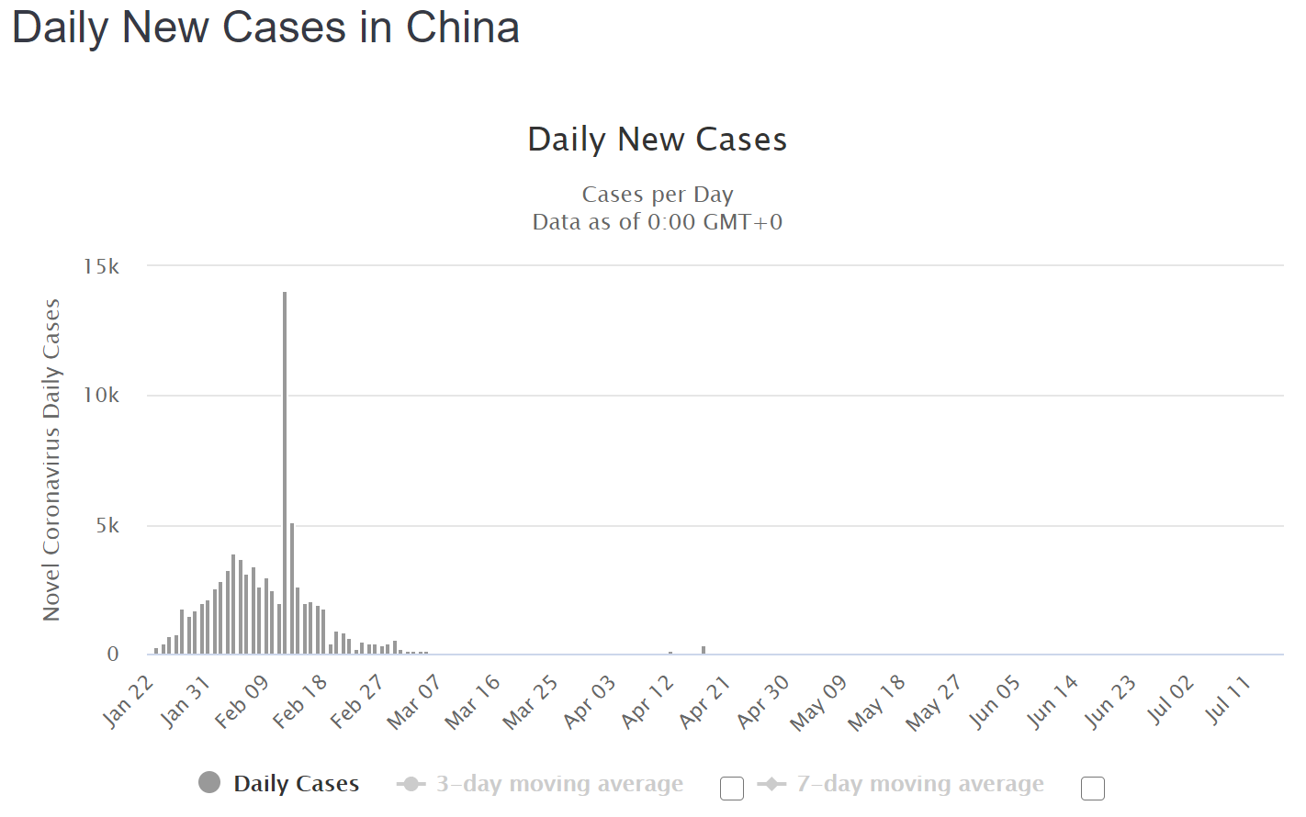
Dealing with Extraneous Data Points
Some countries have retroactively increased or decreased daily incidents to account for counting or other discrepancies. This data either needs to be completely removed, to equally distributed across the prior two weeks.

Slide 40
Analysis Methods
What methods will be used to determine if relationships exist between my metrics and existing rankings/metrics.

Slide 41
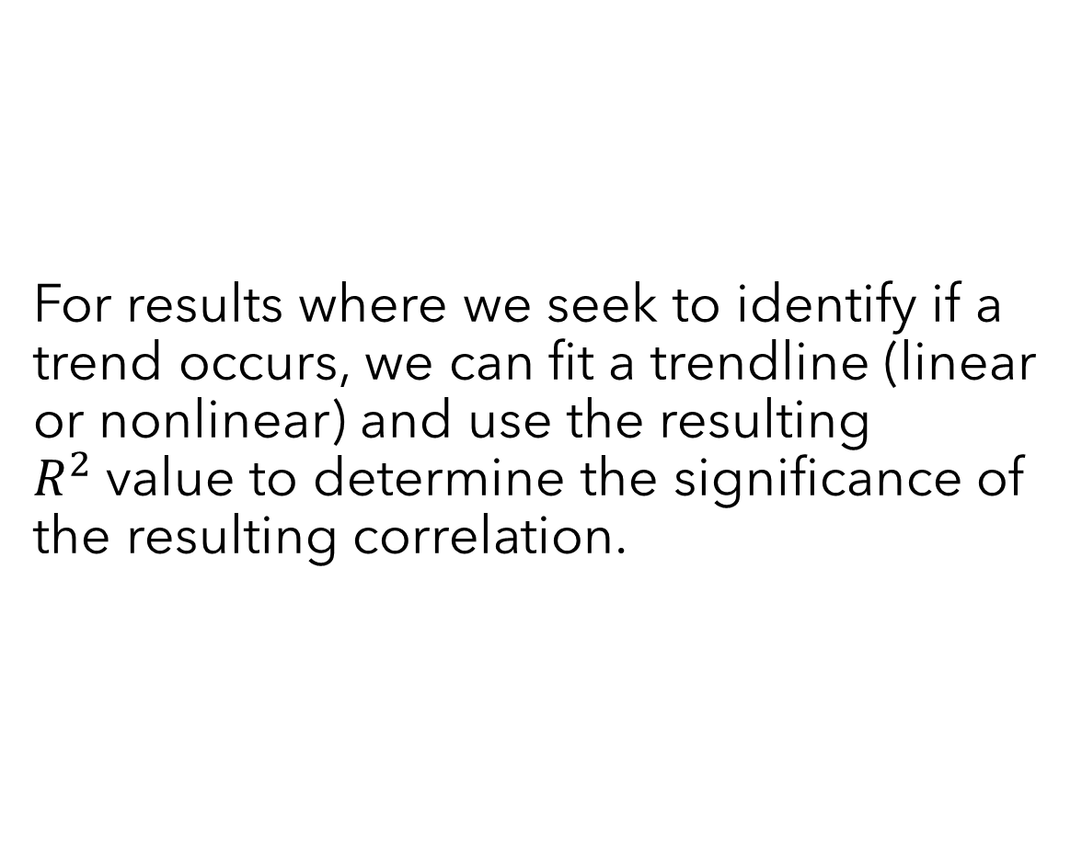
Trend Analysis
For results where we seek to identify if a trend occurs, we can fit a trendline (linear or nonlinear) and use the resulting $R^{2}$value to determine the significance of the resulting correlation.

Slide 42
ANOVA Analysis
For the analysis of comparison results, we can use ANOVA Analysis to determine if a significant difference between the data occurs via T-Tests or other statistical tests.

Slide 43
Additional Work – My Pandemic Response Rankings
If time allows, as an addendum to my research, it may be interesting to create my own rankings of a country’s pandemic response based off the COVID-19 metrics I calculate by utilizing ratio scaling methods.

Slide 44
Sources
[1] https://apps.who.int/gpmb/assets/annual_report/GPMB_annualreport_2019.pdf
[2] https://www.medelahealthcare.com/en-GB/insights/fighting-the-pandemic-takes-preparation
[3] https://www.mckinsey.com/business-functions/risk/our-insights/covid-19-implications-for-business#
[4] https://www.mckinsey.com/business-functions/operations/our-insights/supply-chain-risk-management-is-back
[5] https://www.ghsindex.org/about/
[6] https://github.com/CSSEGISandData/COVID-19/tree/master/csse_covid_19_data
[7] https://github.com/owid/covid-19-data/tree/master/public/data
[8] https://www.imf.org/external/pubs/ft/weo/2020/01/weodata/index.aspx
[9] https://www.who.int/healthinfo/paper30.pdf?ua=1
[10] https://rsf.org/en/ranking
[11] https://www.bsg.ox.ac.uk/research/research-projects/coronavirus-government-response-tracker

